Slide 1


Identifying Risk Factors and Preferred Hospitals for Hip/Knee Replacements: An Analysis of 2019-2022 Hospital Readmission Reduction Program Data
Team Iota
Scott Eugley and Adeline Casali

Slide 2
Background
Hospital Readmission Reduction Program (HRRP)
Average cost of readmission after hip/knee surgery = $8,588 (Phillips et al., 2019)
Insights from this analysis can help health insurance companies guide patients towards hospitals with better outcomes, thereby improving patient outcomes and reducing costs
Notes:
Since 2012, the Centers for Medicare and Medicaid Services have implemented the Hospital Readmission Reduction Program (HRRP). This program tracks hospital readmission rates and incentivizes hospitals to reduce unnecessary readmissions through financial penalties. Using 2019-2022 readmission data from the HRRP, this analysis aims to identify the preferred and non-preferred hospitals for hip and knee replacements for a health insurance company. Furthermore, it will examine the risk factors associated with higher readmission rates for these procedures.
The insights from this analysis can be used to improve hospital performance, enhance patient care, and reduce costs. As of 2019, the average cost of readmission after hip/knee surgery was $8,588, and avoiding that cost would be highly beneficial, in particular for health insurance companies (our stakeholder for this project) (Phillips et al., 2019).

Slide 3
Question, Hypothesis, and Prediction
Question: What risk factors are associated with hospital readmission rates for hip/knee replacements?
Hypothesis: Hospitals with better Hospital Consumer Assessment of Healthcare Providers and Systems (HCAHPS) scores will have lower readmission rates for hip/knee replacements because higher patient satisfaction often correlates with better overall care quality and patient outcomes, including reduced complications and better post-discharge support (Edwards et al., 2015).
Prediction: The most important variables influencing readmission rates for patients after hip or knee replacement surgery will be a combination of high HCAHPS scores and reduced rates of clinical complications.
Notes:
In this analysis, we seek to answer the following question: What risk factors are associated with hospital readmission rates for hip/knee replacements? We hypothesize that hospitals with better Hospital Consumer Assessment of Healthcare Providers and Systems (HCAHPS) scores will have lower readmission rates for hip/knee replacements because higher patient satisfaction often correlates with better overall care quality and patient outcomes, including reduced complications and better post-discharge support (Edwards et al., 2015). It is anticipated that patient satisfaction, clinical treatment quality, and operational efficiency will be the most important risk factor categories associated with hospital readmission rates among patients who have had hip or knee replacement surgery. The most important variables influencing readmission rates for patients after hip or knee replacement surgery will most likely be a combination of high HCAHPS scores and reduced rates of clinical complications.

Slide 4
Data Source
Data provided by the Centers for Medicare & Medicaid Services (CMS)
Datasets allow comparison of the quality of care provided in Medicare-certified hospitals, Veterans Administration (VA) medical centers, and Department of Defense (DoD) hospitals nationwide
Training data: 2019-2022
Testing data: 2024 snapshot (from 04/24/2024)
Many missing values (129177) in initial data
Notes:
We use datasets from the Centers for Medicare and Medicaid Services, which allow for the comparison of the quality of care provided in Medicare-certified hospitals, Veterans Administration (VA) medical centers, and Department of Defense (DoD) hospitals nationwide. For our training dataset, we include HRRP data from 2019-2022. We then test the model using the most recent snapshot of the data from 04-24-2024. Although the original dataset had many missing values (129177 in initial dataset), our final dataset contained 1833 observations across 21 variables.

Slide 5
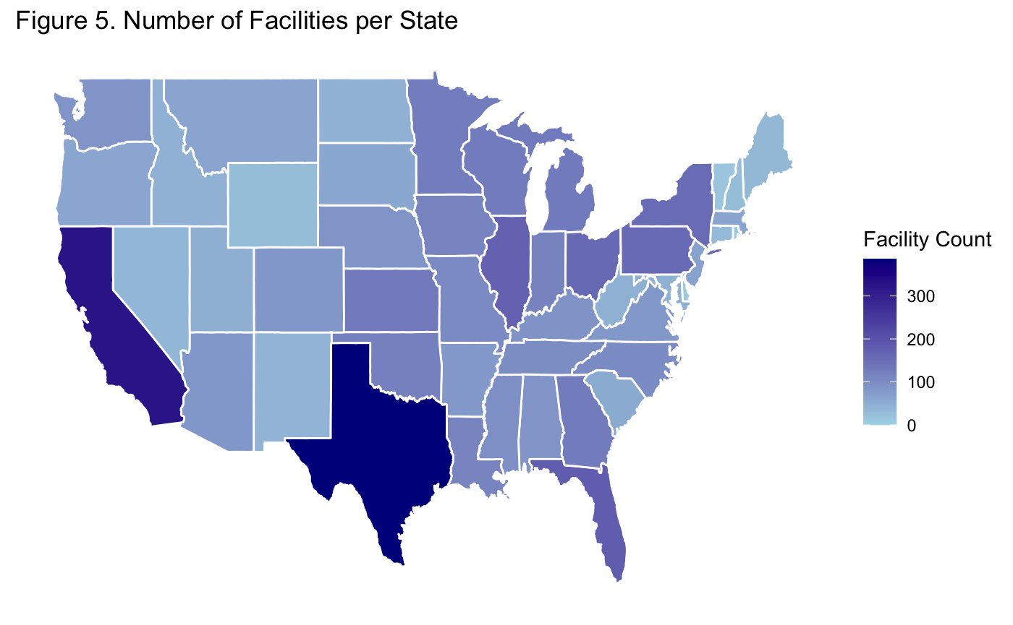
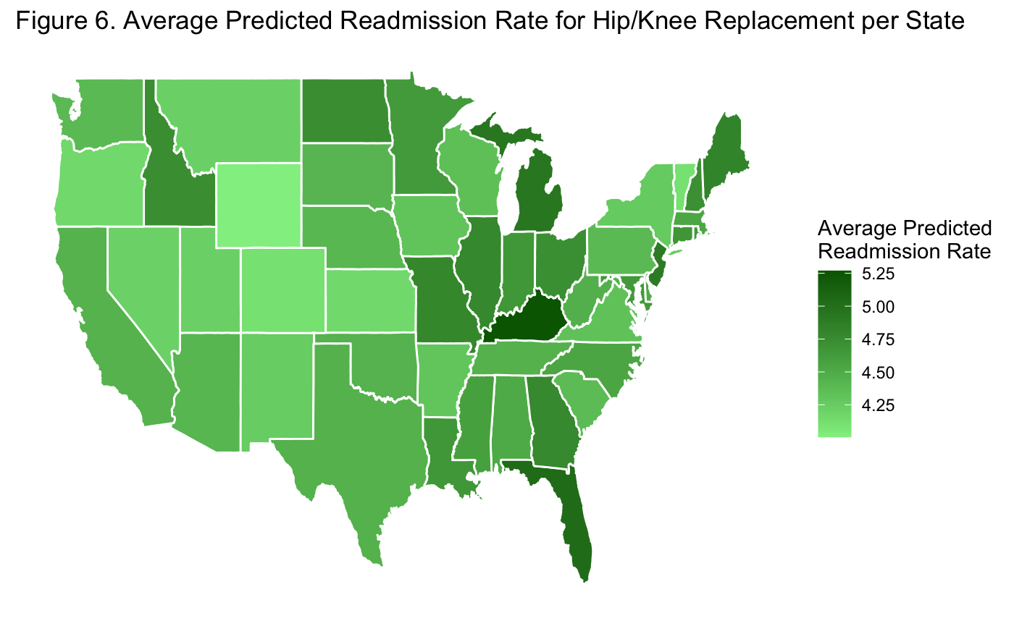
Data Exploration

Slide 6
Data Cleaning
Joined multiple datasets:
HCAHPS (Hospital Consumer Assessment of Healthcare Providers and Systems)
Timely and Effective Care
Complications and Deaths
Payment and Spending
Dealing with NA values:
Removed variables with >80% missing values
Imputed with median for variables with <5% missing values
Imputed with kNN for variables with >5% missing values
Removed correlated and redundant variables
Final dataset: 1833 observations, 21 variables
Repeated steps for 2024 test data
Notes:
HCAHPS (Hospital Consumer Assessment of Healthcare Providers and Systems) dataset as well as Timely and Effective Care, containing information on average wait times and vaccination compliance, Complications and Deaths, containing information about the frequency of deaths and complications for procedures, and Payment and Spending metrics, which includes the costs associated with procedures.

Slide 7
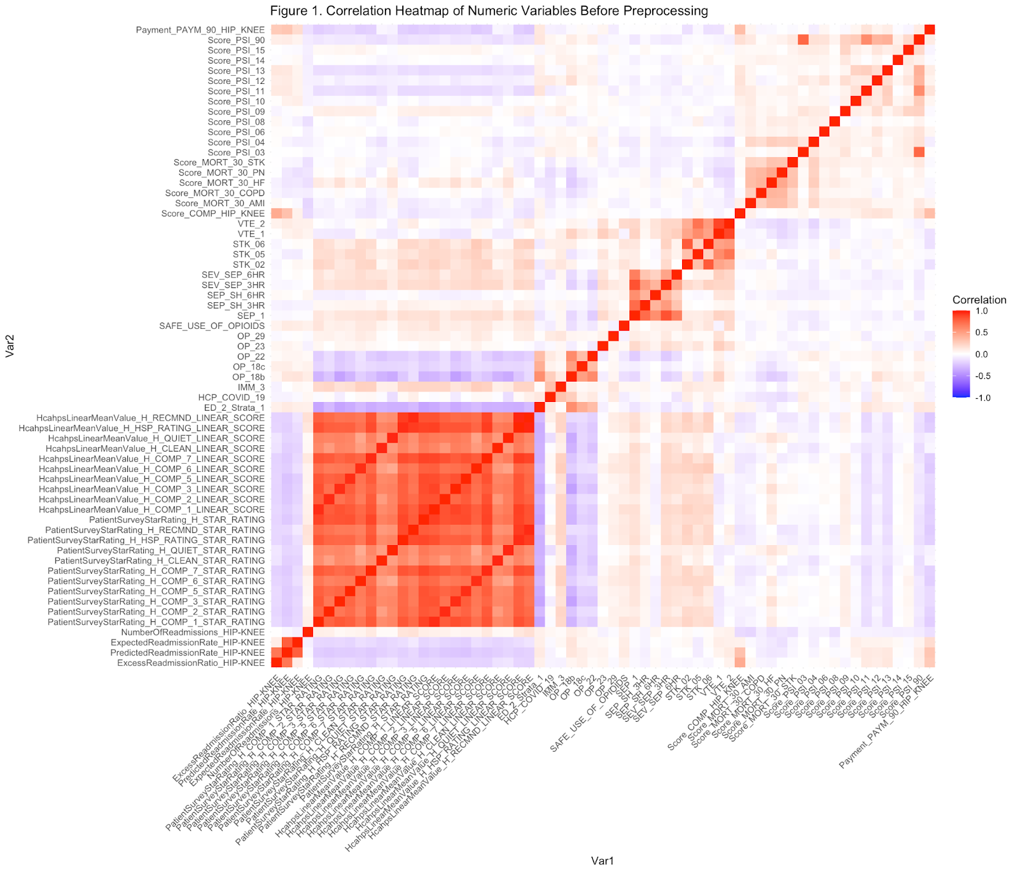
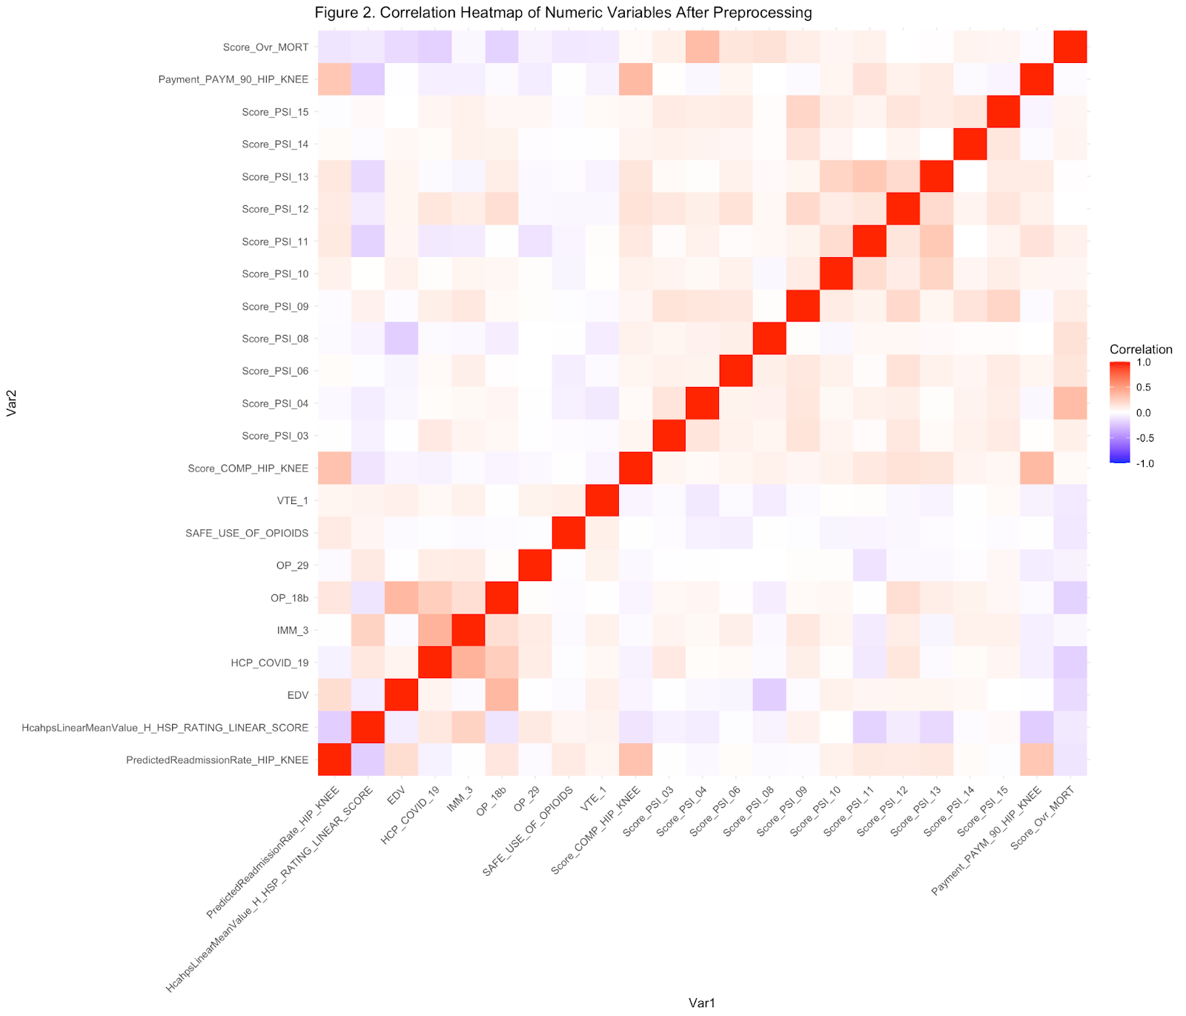
Correlation Heatmaps: Before and After

Slide 8
Methods
Target variable: Predicted Readmission Rate
Qualitative variable (Preferred or non-preferred)
Based on national median predicted readmission rate
Three models:
Random Forest - robust at overfitting, can handle complex interactions
Support Vector Machine (SVM) - effective for non-linear relationships
Logistic Regression - straightforward, interpretable baseline
Notes:
The number of readmissions within 30 days predicted based on the hospital’s performance with its observed case mix. The predicted number of readmissions is estimated using a hospital-specific intercept, and is intended to reflect the annual expected performance of the hospital given its historical case and patient mix and performance. Utilizing this metric instead of the crude observed readmission rate reduced the number of missing values and increases comparability.
These three models were chosen for their complementary strengths: Random Forest is robust to overfitting and can handle complex interactions, SVM is effective in high-dimensional spaces and for non-linear relationships, and Logistic Regression provides a straightforward, interpretable baseline for comparison. Together, they offer a diverse perspective on the data and help ensure reliable predictions.

Slide 9
Findings
The Qualitative Random Forest Model Performed Best
Grid Search for optimal ntrees and mtry
Repeated CV
Most significant features: Broken hip from a fall after surgery, respiratory failure after surgery, accidental cuts and tears from medical treatment, % of patients prescribed 2 or more opioids or opioid + benzo at discharge, and overall hospital satisfaction rating.
Accuracy: 0.98 and AUC: 0.99
Performance of Other Models
Logistic: 0.53 accuracy and 0.72 AUC
SVM: 0.63 accuracy and 0.69 AUC

Slide 10
Key Takeaways
Model performance suggests non-linear, complex relationships in the data
Random Forest was able to more effectively pick up on these relationships
Classification models showed more modest performance (compared to quantitative models), which suggests the difficulty in predicting a binary outcome given this set of features.
Overall hospital satisfaction as rated by the patient was consistently a significant predictor in readmission rate for hip/knee patients.

Slide 11
Conclusions and Recommendations
Despite good performance Random Forest model is suspected to be overfit and possibly experiencing some data leakage.
All models underwent extensive tuning and cross validation, suggesting the issue behind model performance is most likely within the data.
Additional features and preprocessing steps are recommended.
An additional model to consider is XGBoost, due to its ability to handle missing values, as we encountered many missing values amongst many of the features in this dataset

Slide 12
References
Centers for Medicare & Medicaid Services. (2024). 2024 Hospital Readmissions Reduction Program (HRRP) Data. CMS. https://data.cms.gov/provider-data/topics/hospitals
Edwards, P. K., Levine, M., Cullinan, K., Newbern, G., & Barnes, C. L. (2015). Avoiding readmissions—support systems required after discharge to continue rapid recovery? The Journal of Arthroplasty, 30(4), 527–530. https://doi.org/10.1016/j.arth.2014.12.029
Phillips, J. L. H., Rondon, A. J., Vannello, C., Fillingham, Y. A., Austin, M. S., & Courtney, P. M. (2019). How much does a readmission cost the bundle following primary hip and knee arthroplasty? The Journal of Arthroplasty, 34(5), 819–823. https://doi.org/10.1016/j.arth.2019.01.029

